Slide 1
Trainer:
Sharon Amesu
Harnessing Parent Potential

Slide 2
Aims and Objectives
Aim
Promoting parental awareness and understanding of the potential of the Parent/ Teacher Partnership to improve the outcomes for our children.
Objectives
Explore research around the impact of parental engagement with children’s learning.
Explore definitions of parental engagement and involvement.
Look at some of the barriers that undermine parental engagement and involvement.
Look at research based benefits of engagement.
Explore practical ways we can improve parental engagement at school and at home.

Slide 3
Research
Report commissioned by DfES 2003.
‘The Impact of Parental Involvement, Parental Support and Family Education on Pupil Achievement.’
Professor Charles Desforges and Alberto Abouchaar.
University of Exeter
Report Commissioned by DCSF 2007
‘Engaging Parents in Raising Achievement.
Do Parents Know They Matter?’
Professor Alma Harris and Dr Janet Goodall
University of Warwick

Slide 4
Why Parent Potential?
“Parents are a child’s first and enduring teachers. They play a crucial role in helping their children learn.”
DfES 2003
“Parents play a vital role in the development and education of their children and in the success of schools.”
DCSF 2007

Slide 5
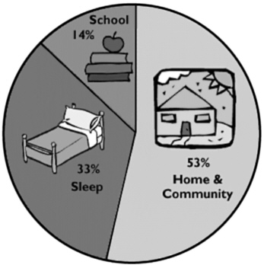

Slide 6
Research
2007 Report
“Parental engagement in ‘supporting learning in the home’ remains the single most positive influence on student achievement.”

Slide 7
“..one of the major concerns in running a modern school is trying to get parents to engage more.”
Clare Campbell
National College for School Leadership 2011

Slide 9
National Literacy Trust

Slide 10
HELP!

Slide 11
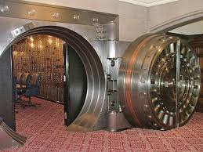

Slide 12
What is the difference between
Parental Involvement
and
Parental Engagement?

Slide 13
Involvement is:
"to enfold or envelope,"
Engagement is to:
"to come together and interlock." Thus, involvement implies doing to; in contrast
Engagement implies doing with.

Slide 14
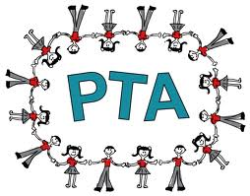
Parental Involvement?
School focussed
Activities such as Coffee Mornings
PTA’s
Volunteering in School

Slide 15
Parental Engagement?
Moral Support.
Valuing education.
Achievement and Behaviour.
Homework.

Slide 16
Barriers to Parental Engagement
Put these Barriers in Order
Parents Experience of Education
Parents lack of skills
The school itself
Practical Issues
Attitude of the Child
Perceived Teacher Attitude
Parents not interested

Slide 17
Barriers To Parental Engagement

Slide 18
Benefits for Children
Children achieve more/better overall outcomes
Children have improved self-esteem, are more self-disciplined, and show higher aspirations and motivation toward school.
Children's positive attitude about school often results in improved behaviour in school and less disciplinary issues.
Fewer children are being placed in special education and remedial classes.
Children from diverse cultural backgrounds tend to do better when parents and professionals work together to bridge the gap between the culture at home and the culture in school.

Slide 19
Benefits for the Parents
Increased interaction and discussion with their children .
Parents are more confident in their parenting and decision-making skills.
More knowledge of child development
Better understanding of the teacher's job and school curriculum.
More awareness of what their children are learning and more likely to help when asked by teachers with learning activities at home.
Parents' perceptions of the school are improved and there are stronger ties and commitment to the school.

Slide 20
Benefits for the Staff and School
Higher morale.
Greater respect for their profession from the parents.
Improved communication and relations between parents, teachers, and administrators.
Better understanding of families' cultures and diversity, and they form deeper respect for parents' abilities and time.
Increase in job satisfaction.
Better community relationships and support.
Schools also experience better community support.

Slide 21
How does your school currently facilitate overcoming the barriers of parental engagement/involvement?
How might engagement be improved?

Slide 23
Parents and School
Openness in Communication
Parents associations, coffee mornings, getting a better understanding of school structures and the curriculum.
Parents evenings.
Social Media groups.
Parents Advocacy Groups
Taking advantage of open door policy
School leadership (parent governors)

Slide 24
Parents Evenings-
Prepare Questions
Can you give me a breakdown of the subjects covering in class and some ideas about how we can extend the learning at home.
How can I help my child move up to the next target grade.
Recommend resources or activities?
In the areas of challenge are you using different teaching strategies to suit his learning style?

Slide 25
Paradigm Shift Theory of Multiple Intelligences Howard Gardner
intelligence type | capability and perception
Linguistic | words and language
Logical-Mathematical | logic and numbers
Musical | music, sound, rhythm
Bodily-Kinesthetic | body movement control
Spatial-Visual | images and space
Interpersonal | other people's feelings
Intrapersonal | self-awareness

Slide 26
Practical Application Parents and Children
Have you had a good day?
What did you do at school today?
Structure it even more deeply and openly:-
What’s the most interesting thing you did at school today?
(encourages thought, analysis and evaluation.)

Slide 27
Things to bear in mind……
-Challenge.
-Encouragement and praise.
-Timing
-Body language
-Listen, listen, and listen
-Be creative and use humour
-Manage anxiety
-Technology

Slide 28
Conclusion
Aims and Objectives
Raise our awareness and increase our understanding of the potential we have as parents to improve the outcomes for our children.
Objectives
Look at some of the research around the impact of parental engagement with children’s learning.
Explore definitions of parental engagement and parent involvement.
Look at some of the barriers which might undermine parental engagement.
Look at research based benefits of engagement.
Explore practical ways we can improve parental engagement at school and at home.

Slide 29
Further Reading
-www.the schoolrun.com
-www.campaign- for- learning.org.uk
-www.gov.uk/national-curriculum/overview
-Parents First Kay Jarvis and Gary Burnett
-DCSF Report 2007 “Engaging Parents in Raising Achievement”
-DfES Report 2003 “The Impact of Parental, Parental Support and Family Education on Pupil Achievement and Adjustment.”
-White Paper 1997 “Excellence in Schools”
-DFE 2010 “Review of Best Practice in Parental Engagement.”
-http://www.parenting.com/article/learning-quiz
-www.cyberbullyingnews.com/2010/07/oh- nothing-much-report-the-value-of-the-after-school-conversation/
-www.parentandcarerengagement.org.uk/pet8.pdf
-www.educationscotland.gov.uk/Images/Toolkit_tcm4-373859.pdf
- Your school website.

