Slide 1
Welcome to our Key Stage One Handwriting Information Evening for Parents.

Slide 2
Aims of Evening
Progression in handwriting and the National Curriculum.
Find out our school approach and our handwriting scheme.
Issues that may arise when teaching children to write.
How you can help at home.

Slide 3
Outline of the Evening
Brief introduction
Work in Year Groups - learn more about our handwriting scheme, a chance to practise handwriting, and how you can help at home
Return to staff room at the end for a few minutes to complete evaluations and ask any further questions.

Slide 4
Why is handwriting important?
Children who have better handwriting are usually better at spelling
Children who can write fluently are relieved of thinking about how to write, instead they can focus on what they are writing
More motivation to write
To achieve the Expected Standard in Writing in Key Stage One SATs children need to “write capital letters and digits of the correct size, orientation and relationship to one another and to lower case letters”
To achieve Greater Depth in Writing children need to “use the diagonal and horizontal strokes needed to join letters in most of their writing.”

Slide 5
Pre-Writing Skills
Gross motor control – crawling, ball skills, hopping, jumping, dancing, cycling, climbing
Fine motor skills – cutting, threading, modelling, pattern making and sticking
Encouraging pincer movements of the fingers
Providing a range of pens, pencils and brushes for children to experiment with.

Slide 6
National Curriculum 2014 - Year 1
Handwriting
Pupils should be taught to:
Sit correctly at a table, holding a pencil comfortably and correctly
form lower case letters in the correct direction, starting and finishing in the right place
form capital letters
form digits 0-9
understands which letters belong to which handwriting families (i.e. letters that are formed in similar ways) and to practise these
Leave spaces between words.

Slide 7
National Curriculum 2014 - Year 2
Handwriting
Pupils should be taught to:
form lower case letters of the correct size relative to one another
start using some of the diagonal and horizontal strokes needed to join letters and understand which letters, when adjacent to one another, are best left unjoined
write capital letters and digits of the correct size, orientation and relationship to one another and to lower case letters
use spacing between words that reflect the size of the letters.

Slide 8
National Curriculum 2014
Year 3 and 4
Year 5 and 6
Pupil should be taught to:
use the diagonal and horizontal strokes that are needed to join letters and understand which letters, when adjacent to one another are best left unjoined
Increase the legibility, consistency and quality of their handwriting.
Pupils should be taught to:
write legibly, fluently and with increasing speed by:
choosing which shape of a letter to use when given choices and
deciding whether or not join specific letters
choosing the writing implement that is best suited for a task.

Slide 9
Handwriting at Templemoor
Previously used Spectrum Handwriting Scheme
Evaluated a range of schemes
Liaised with Moorlands Junior School
Chose Nelson Handwriting Scheme

Slide 10
Nelson Handwriting Scheme
Starter level - Reception
a b c d e f g h I j k l m n o p q r s t u v w x y z
Lower case for books 1-6
a b c d e f g h I j k l m n o p q r s t u v w x y z
f k change in Year 1
The joined style

Slide 11
Key Messages about the Nelson Scheme
In Reception children will be taught print f and k.
In Year One children will be taught to write the cursive f and k.
f k

Slide 12
Letter families
In Year One correct letter formation is reviewed using letter families, grouped according to similar handwriting movements.
Set 1
c a o d g q s f e
Set 2
i l t u j y
Set 3
r n m b p h k
Set 4
v w x z

Slide 13
Letter joins
Joining letters will be introduced midway through Year One (or once children can confidently form and write letters)
There are 4 different letter joins:
-diagonal join to letter without ascenders
- diagonal join to a letters with ascenders
-horizontal join to letters without ascenders
-join from the top of a small letter to top of a tall letter (ascender)

Slide 14
Break letters
Not all letters are joined
The following are break letters – these do not join to the next letter.
b, p, g, q, y, j, x, z,

Slide 15
Specific handwriting difficulties
Faulty pencil grip
Incorrect letter formation
Reversals, inversions
Poor posture

Slide 16
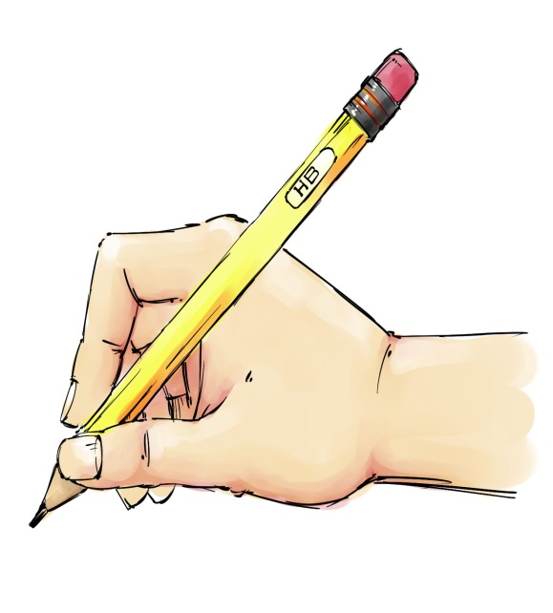
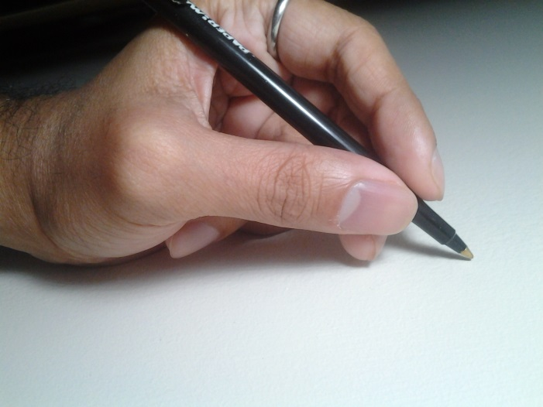
Pencil Grip
The ideal grip (tripod grip) looks like this:
The left hand grip is the same but the pencil should be held higher up the barrel so the writing can be clearly seen.

